Slide 1








Discover the World with Business
Organized By-
Strategic Partner
In Association

Slide 2
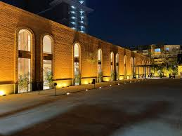


Prospective Date
Probable Venue
FRIDAY
SATURDAY
04
th
05
th
SEPTEMBER, 2026
ITTE
10:00-21:30
EVENT
DETAILS

Slide 3
OBJECTIVES
This fair will be a combined gathering of tourism, culture, and youth, featuring cultural participation of international students residing in Bangladesh, live cultural performances from different countries, and fashion shows.
To present Bangladesh as an international tourism hub.
BACKGROUND
The International Tourism Fair 2026 is a landmark initiative jointly organized by Nagorik Protidin and Bloodman, aimed at positioning Bangladesh as a global tourism hub and an international connecting platform.

Slide 4


Tourism Hub
Center of Trade
Cultural Diplomacy
To strengthen partnerships and commercial connections among different countries’ embassies, tourism boards, and international tourism brands
To engage international students and connect them with the tourism and culture of Bangladesh
KEY
OBJECTIVES
To present Bangladesh as an international tourism hub

Slide 5




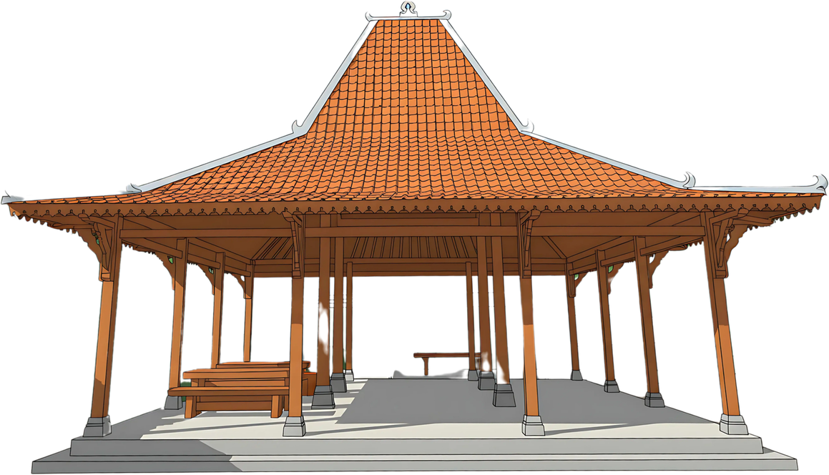
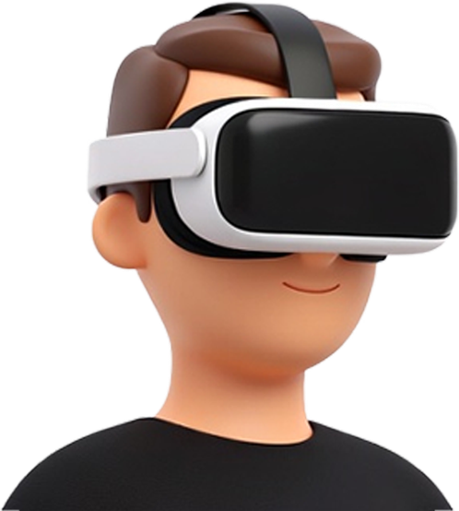
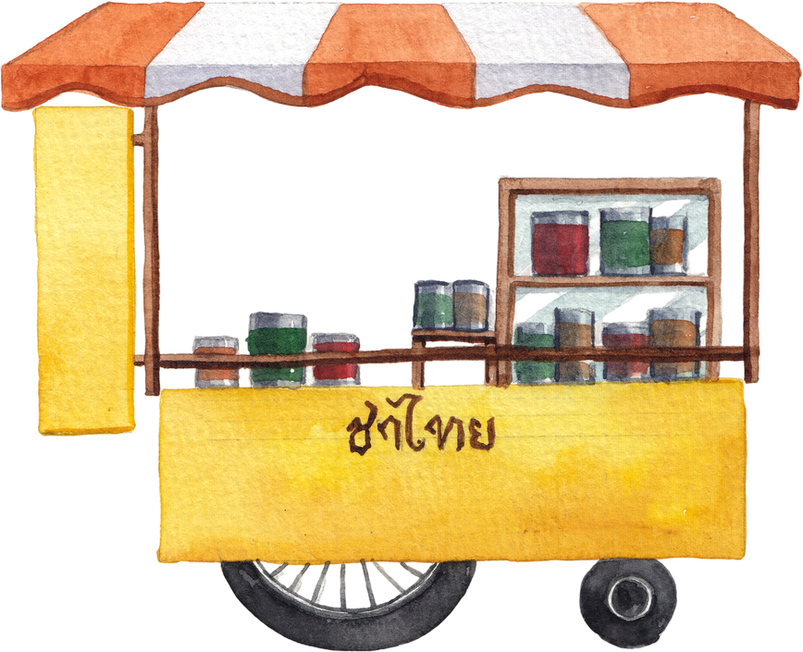

Corporate Booth
A dedicated space for brands to showcase offerings and build strategic business connections
International Pavillion
A dedicated zone featuring different embassies showcasing their country’s tourism, culture, and opportunities
Selfie Booth
A creative setup for visitors to capture and instantly share memorable moments.
Medical Corner
A support zone offering basic health check-ups and emergency assistance
PARTICIPANTS
DETAIL
Foreign Pavilion
Country-themed booths presenting global culture, tourism, and heritage
VR Experience Zone
An immersive virtual space to explore international destinations through advanced technology
Food Pavilion
A dynamic food zone featuring a variety of local and international cuisines
Travel Zone
A dedicated area showcasing travel services, packages, and destination opportunities

Slide 6
SPECIAL FEATURE
EXPO PLAN
PROBABLE PERTICIPATION
There will be B2B and B2C sessions, country presentations, seminars, round-table discussions, and cultural shows every evening. As a new addition, there will be an “International Student Cultural Pavilion,” which will make this fair different from other tourism expos.
Nepal, Bhutan, India, Sri Lanka, China, Japan, South Korea, Malaysia, Indonesia, Turkey, Nigeria, Somalia, Saudi Arabia, Egypt, Palestine, Uzbekistan, and other countries.

Slide 7

Day Wise Program
Detail Program plan for 4th & 5th September
Opening Ceremony (10:00 AM – 11:00 AM)
01
01
Conference Session 2 (10:30 AM – 12:00 PM)
Opening Speech by Tourism Minister, Greetings of ambassadors & diplomats, Cultural welcome performance and so on
Theme: “Future of Hospitality & Smart Tourism” and Topics: AI, VR tourism, sustainable travel
Conference Session 1 (11:30 AM – 1:00 PM)
02
02
Youth & Career Summit (2:00 PM – 3:30 PM)
Theme: “Tourism Diplomacy & Economic Growth”, Speakers: Government, UN bodies, tourism boards (TBD),
Hospitality career talks and Internship & recruitment booths
Function Range
03
03
Startup Pitch Session (3:30 PM – 5:00 PM)
Assess the variety and number of features available to meet diverse user needs.
DAY - 01
DAY - 02
Travel-tech startups pitch and Investors & VCs panel
04
Award & Recognition (5:30 PM - 6:30 PM)
Culinary Showcase (1:00 PM – 4:00 PM)
04
Best Tourism Award, Best Airlines Partner Award, Best Hospitality Award, Emerging Travel Award and so on
Live cooking by international chefs & “Taste the World in Dhaka” experience
Cultural Evening (5:30 PM – 8:00 PM)
05
05
Closing & Concert (8:00 PM - 10:00 PM)
Multi-country performances & Fashion show (Traditional Attire of Nations)
Key Highlight Recap, Crest Giving, Cultural Show & Concert

Slide 8
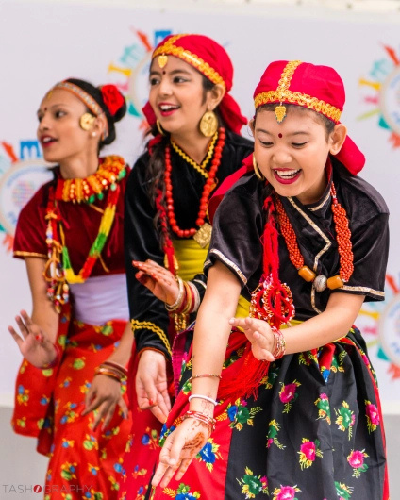
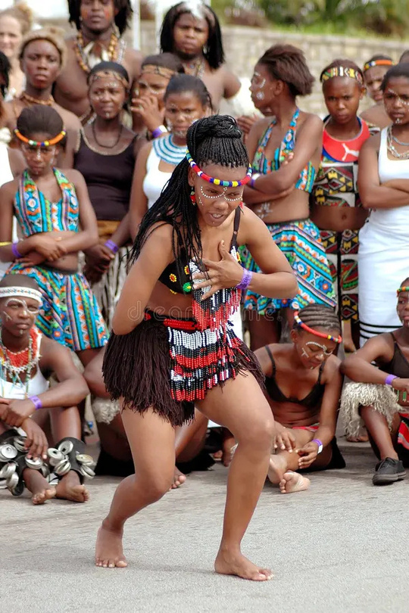
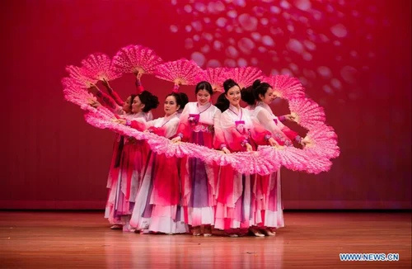
Chinese Dragon Dance
Nepali Folk Dance
African Music

Slide 9
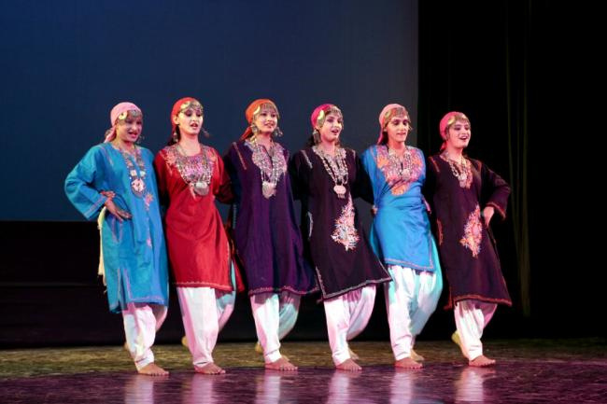
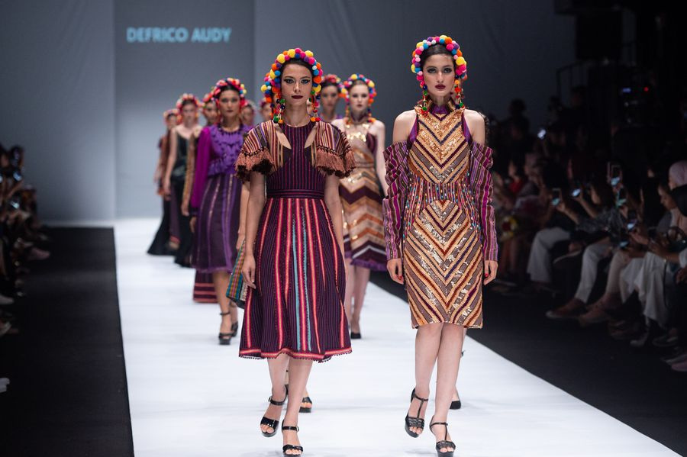
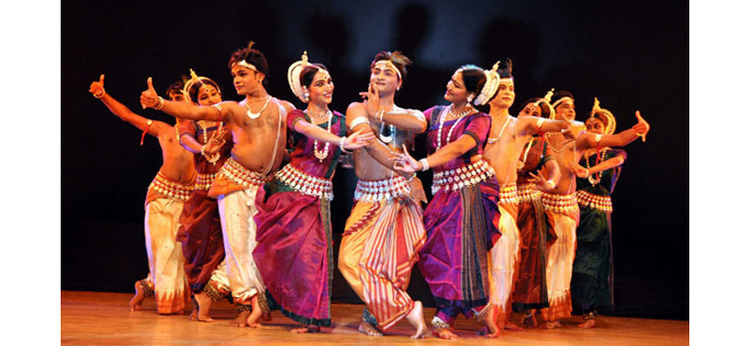
Kashmiri Cultural Dance
MULTI CULTURAL FASHION
Indian Fold Dance

Slide 10
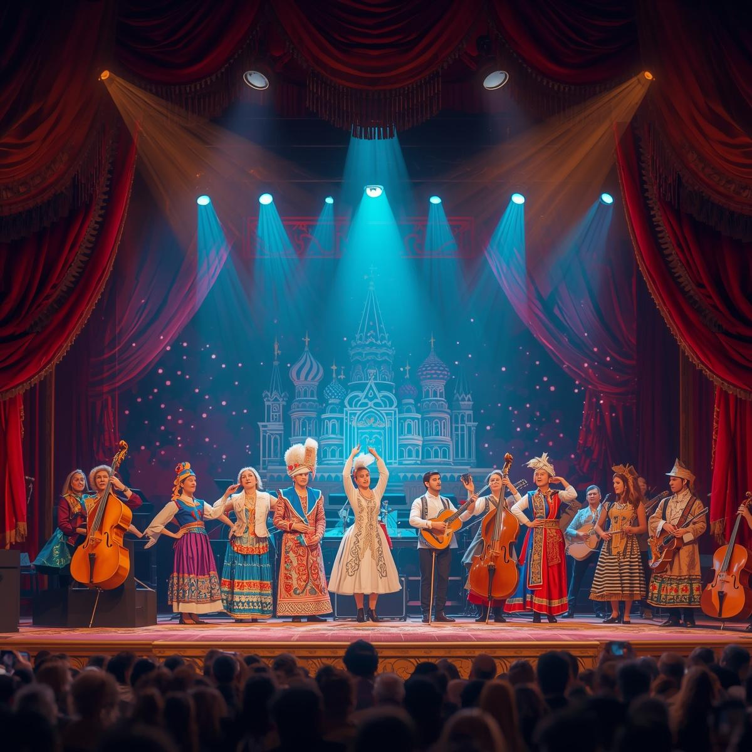
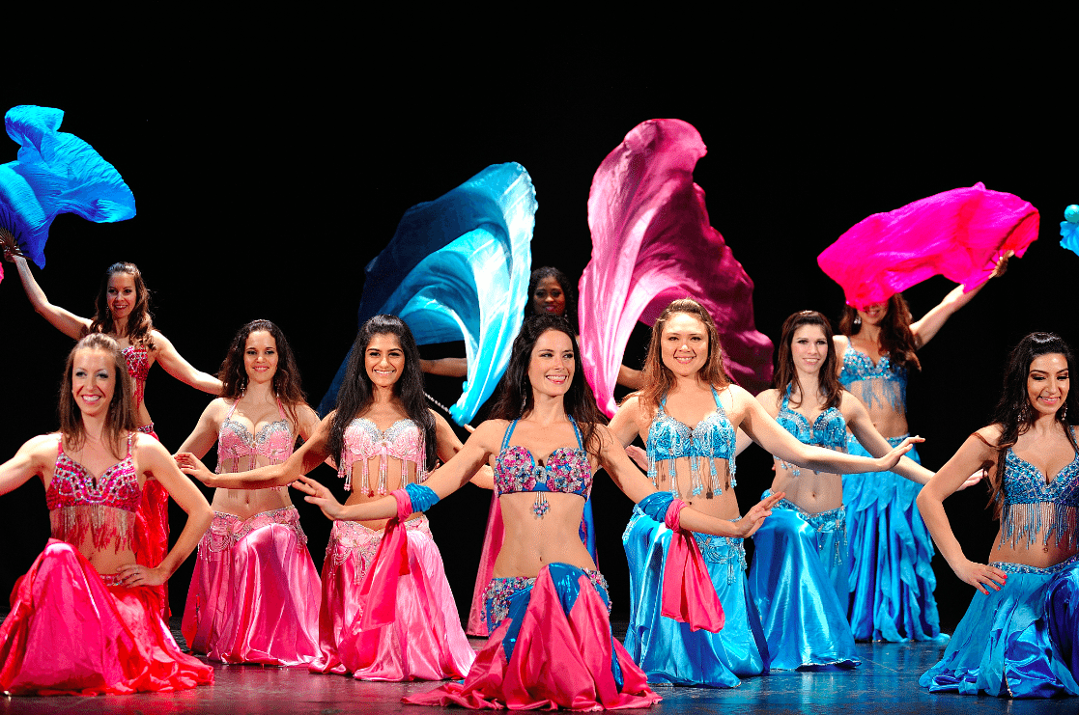
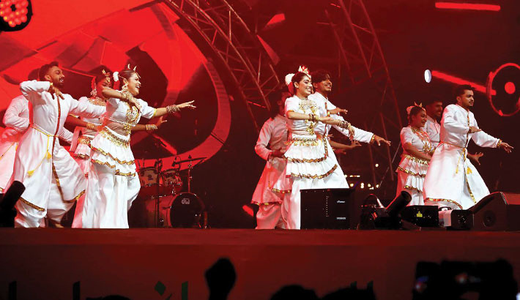
Russian Music Show
Arabian Belly Dance
Bengali Cultural Dance

Slide 11
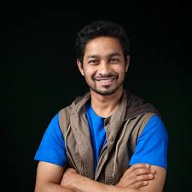
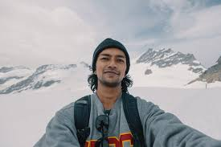

International
Trip Story

Slide 12
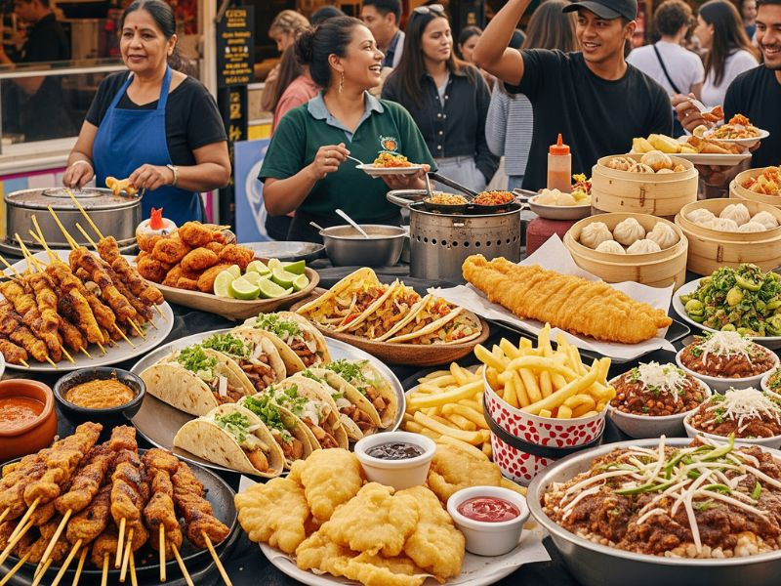
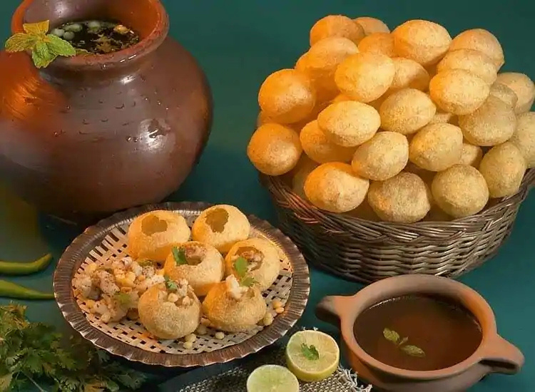
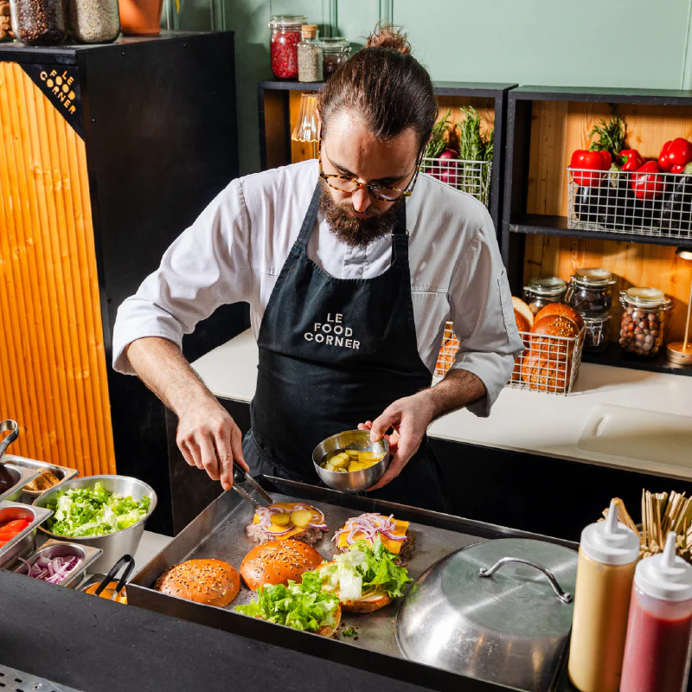
Foreign Food Stall
Traditional Food Stall
Live Kitchen

Slide 13
PROSPECTIVE GUEST
Govt. Important Person
Honorable State Minister / Minister
Secretary of the Ministry
Secretary of the Ministry of Foreign Affairs
High Commissioners/Ambassadors
CORPORATE GUETS
Representatives of international organizations
Country Heads of leading airlines
Hotel and hospitality groups
International student offices
Education consultancy institutions
Regulatory Body
CEO of Bangladesh Tourism Board
Chairman of Bangladesh Parjatan Corporation
Media division of the Ministry

Slide 14
EXPO EXPOSURE
Brand Visibility & Exposure
Sponsor brand name will appear in official title, theme, and tagline. Branding will be visible at main entrance, stage, LED screen, banners, festoons, backdrop, gate, and all collateral categories.
Media & Digital Coverage
Coverage in TV, newspapers, and mass media. Brand exposure in fair awards ceremony live streaming. Inclusion in social media posts, reels, short videos, talk shows, and press releases.
On-ground Activation
Opportunity for premium location brand stall, product & service live demonstration, special offers, discount & campaign activation. Customer data collection and lead generation opportunity.
Foreign Pavilion Sponsorship
Pavilion, cultural show, food & projection- everything will be branded under the sponsor. If ambassador or high officials are present, sponsor brand will get direct diplomatic exposure.
Elite Exposure
Separate sponsor lounge for Ambassadors, Ministers, and CEO/CXOs, where catering, premium branding, and elite exposure will be ensured.
Iconic Photo Booth
“World in One Frame” – iconic background (Eiffel Tower, Taj Mahal, Pyramid, Great Wall, etc.). Visitors can take photos and share on social media with sponsor logo visibility.
AI/AR Travel Experience Booth
Virtual travel experience through AR/VR technology. Visitors can take photos in foreign locations with one click. “Your Next Destination” themed instant photo download option available
Dedicated B2B Area
Premium, comfortable lounge space dedicated to pre-scheduled business meetings, fostering seamless communication and deal-making between tourism companies and potential partners.

Slide 15


SPONSORSHIP OPPORTUNITIES
TITLE SPONSOR | 01 SLOT
BDT 20,00,000
POWERED BY | 01 SLOTS
BDT 12,00,000
Exclusive "Presented by [Your Brand]" positioning on all materials.
Dominant logo visibility on all branding materials.
Web ad placement at Nagorik Protidin for 30 days.
Special promotion in ITTE Magazine.
Present top award on stage to the winner.
Get 50 VVIP Invitation Cards.
Record interviews on different media partners’ platforms.
Title Sponsor booth at the venue.
Exclusive "Powered by [Your Brand]" positioning on all materials.
Dominant logo visibility on all branding materials.
Web ad placement at Nagorik Protidin for 15 days.
Promotion in ITTE Magazine.
Present award on stage to the winner.
Get 30 VVIP Invitation Cards.
Record interviews on different media partners’ platforms.
Powered By Sponsor booth at the venue.

Slide 16
CO-SPONSOR | 03 SLOTS
BDT 800,000
PARTNERS | 07 SLOTS
BDT 500,000
Co-Sponsor [Your Brand]" positioning on all important materials.
Web ad placement at Nagorik Protidin for 10 days.
Promotion in ITTE Magazine.
Present award on stage to category winner.
Get 10 VVIP Invitation Cards.
Record interviews on different media partners’ platforms.
Co-Sponsor booth at the venue.
"Partner [Your Brand]" positioning on all important materials.
Web ad placement at Nagorik Protidin for 05 days.
Promotion in ITTE Magazine.
Present award on stage to category winner.
Get 05 VVIP Invitation Cards.
Record interviews on different media partners’ platforms.
Partners’ booth at the venue.

Slide 17

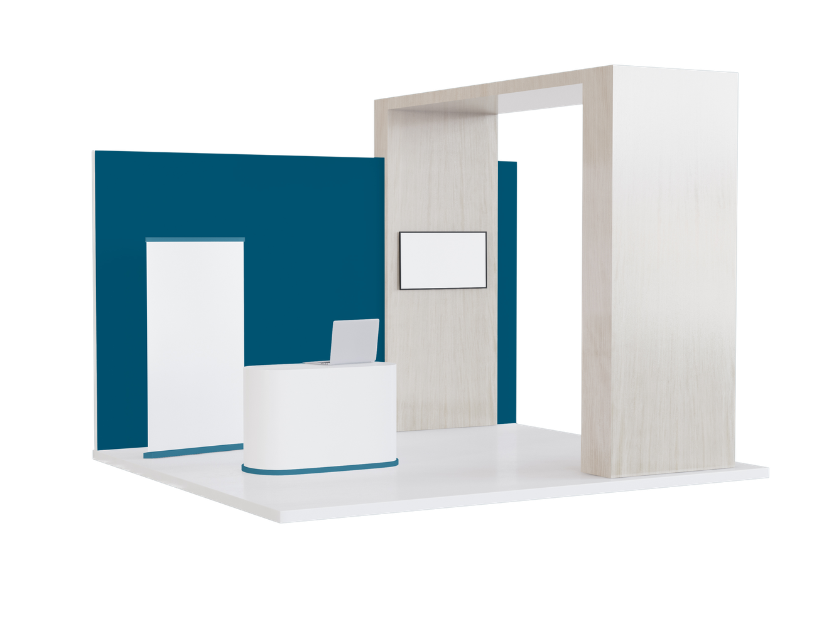
PAVILLION | 04 SLOTS
BDT 50,000
128sqft (approx.) large branded area for massive display.
Record interviews on different media partners’ platforms.
Brand mention on the official website & exhibitor list.
STALL | 100 SLOTS
BDT 35,000
64 sqft (approx.) large branded area for massive display.
Brand mention on the official website & exhibitor list.

Slide 18
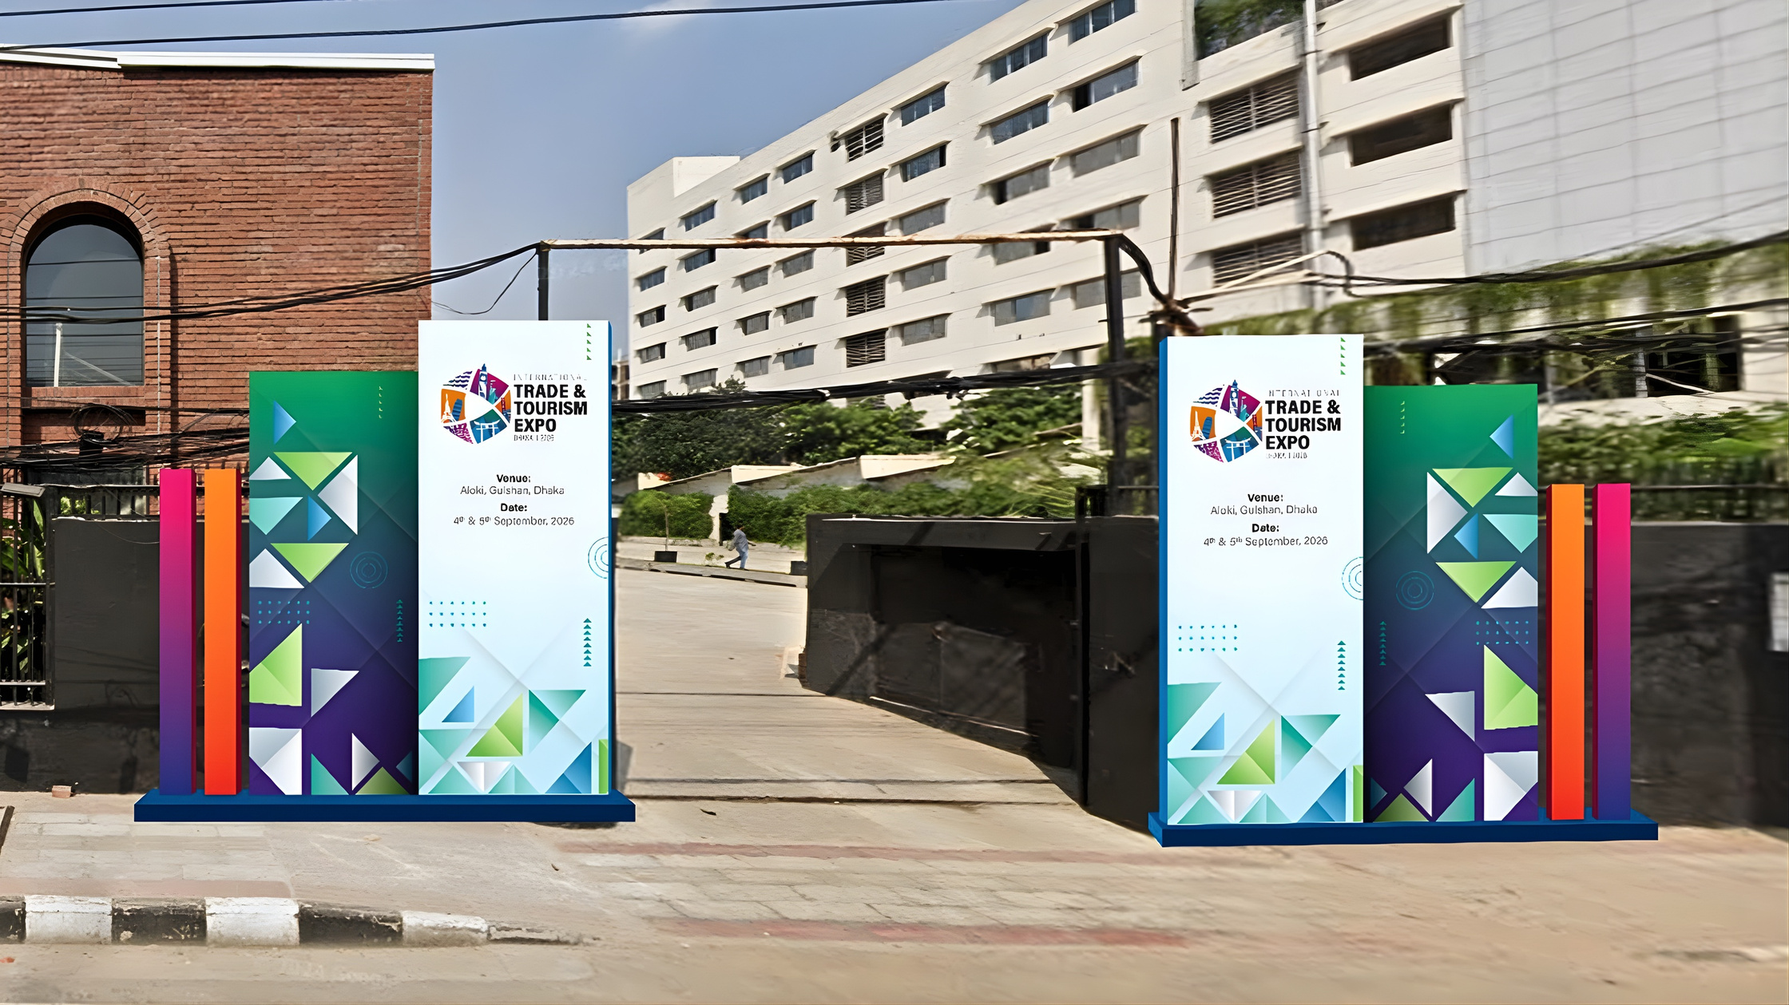

Slide 19
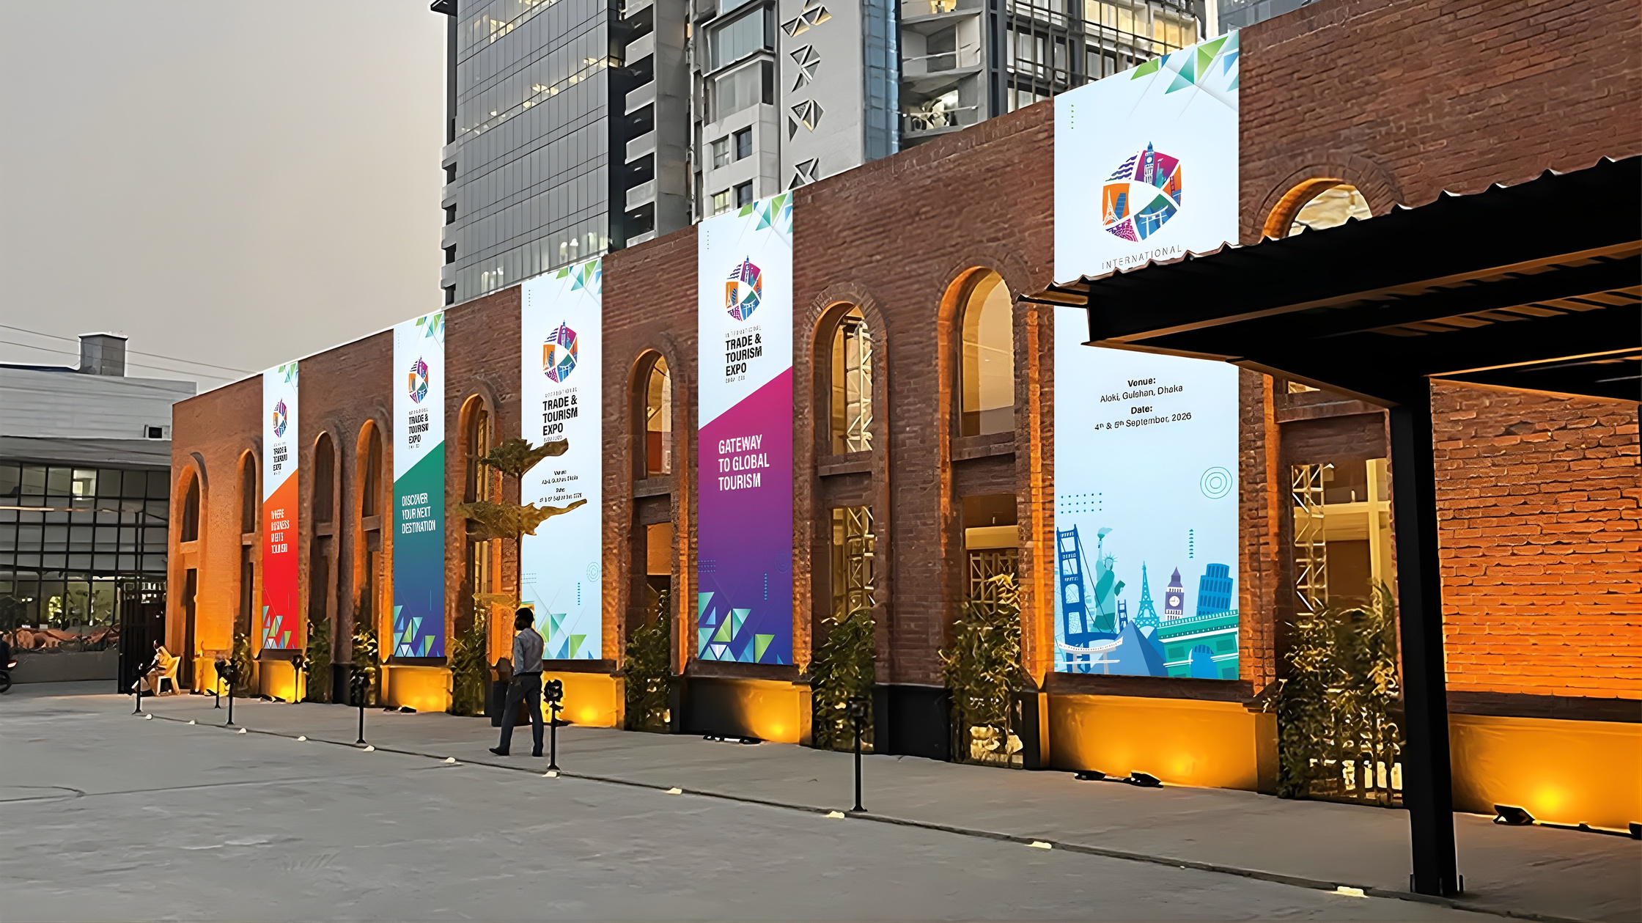

Slide 20

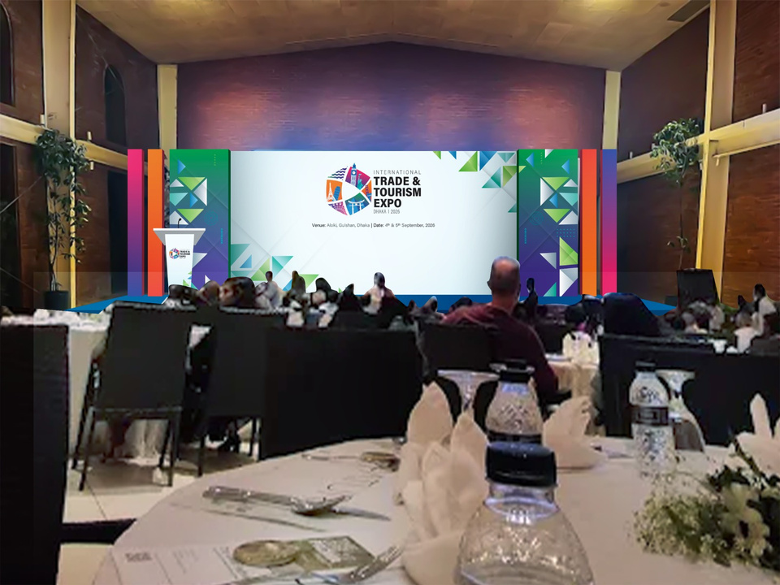

Slide 21
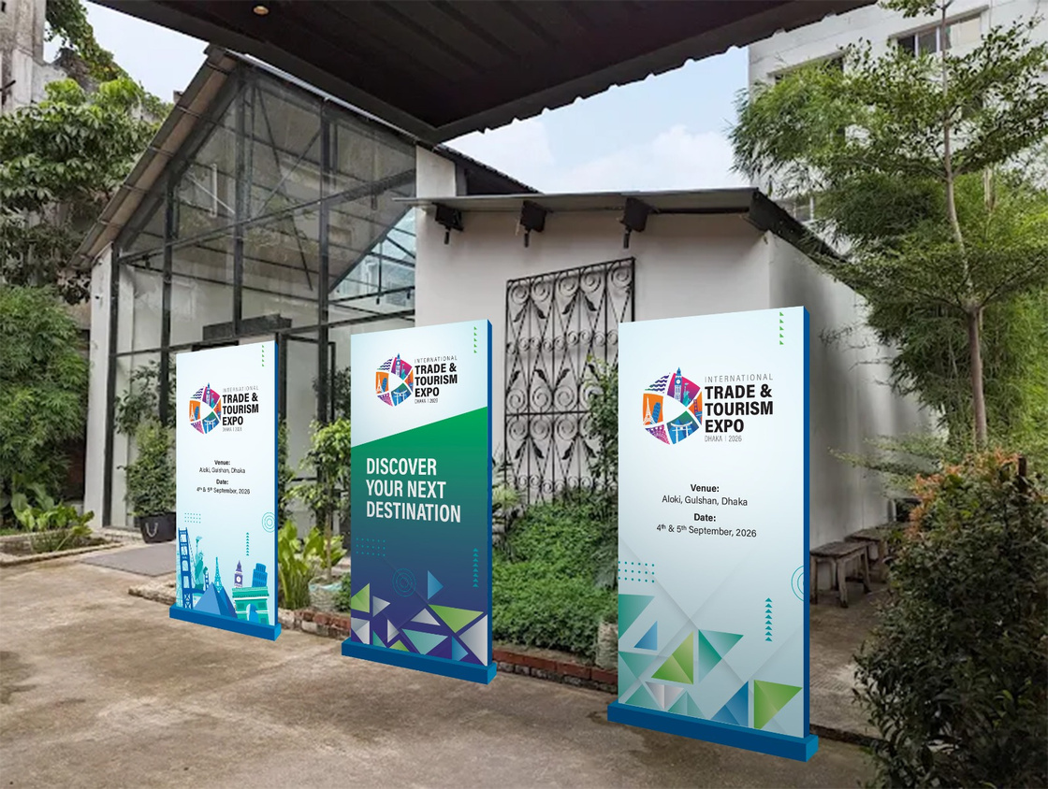


Slide 22


Slide 23
THANK YOU
Nagorik Protidin
+88 01734 991111
sameer@nagorikprotidin.com
www.nagorikprotidin.com
Organized By-
Strategic Partner
In Association

